Slide 1
Planning and Teaching of
Technology Education Key Learning Area Curriculum
and Business Learning Elements
at Junior Secondary Level (Refreshed)
規劃及教授
初中科技教育學習領域課程
及商業學習元素 (修訂)
CSD020250049
Technology Education Section, EDB
12 February 2025

Slide 2
Background of Participants
major subject taught…
major administrative duties…
Subject | % of Enrolment
TE-BAFS | 62%
Other TE Subjects | 16%
PSHE | 6%
ME | 4%
SE | 3%
Ch. Lang. | 3%
N/A | 6%
Post Title | % of Enrolment
Subject Panel Head | 46%
Teaching staff & Class teacher | 32%
School Head & Deputy Head | 16%
IT-in-charge/Careers Guidance Master/STEAM Coordinator/Curriculum Development Coordinator | 6%

Slide 3
Time時間 | Content/Activity內容／活動
2:30 – 2:45 pm | Registration 登記
2:45 – 3:30 pm | Part 1第一部分 Topic 講題 The implementation of TE KLA curriculum (including business learning elements) through holistic curriculum planning at junior secondary level 學校於初中階段通過整體課程規劃以實施科技教育學習領域課程 Speaker講者: Mr POON Hing-fai, Chief Project Manager, Technology Education Section, Curriculum Support Division, Education Bureau 教育局課程支援分部科技教育組總項目經理潘慶輝先生 Highlights of issues when planning and implementing business learning elements at junior secondary level 在規劃與實施初中商業學習元素時的重點事項 Speaker講者: Curriculum Development Officer of Technology Education Section, Curriculum Support Division, Education Bureau 教育局課程支援分部科技教育組課程發展主任

Slide 4
Time時間 | Content/Activity內容／活動
3:30 – 4:45 pm | Part 2第二部分 School Sharing學校分享 Experience Sharing on Planning and Teaching of TE KLA Curriculum (including Business Learning Elements) at Junior Secondary Level 規劃與實施初中科技教育學習領域課程（包括商業學習元素）的經驗分享 Speaker講者: Ms WONG Pui-chi, Principal and Mr CHEUNG Chun-yin, William, Panel Head of Business, Accounting and Financial Studies, Chiu Chow Association Secondary School 潮州會館中學校長黃佩芝女士和企業、會計與財務概論科主任張俊彥先生
4:45 – 5:00 pm | Question and Answer問與答 All Speakers 所有講者

Slide 5
Part 1 第一部分
The implementation of TE KLA curriculum (including business learning elements) through holistic curriculum planning at junior secondary level
學校於初中階段通過整體課程規劃以實施科技教育學習領域課程
Highlights of issues when planning and implementing business learning elements at junior secondary level
在規劃與實施初中商業學習元素時的重點事項

Slide 6
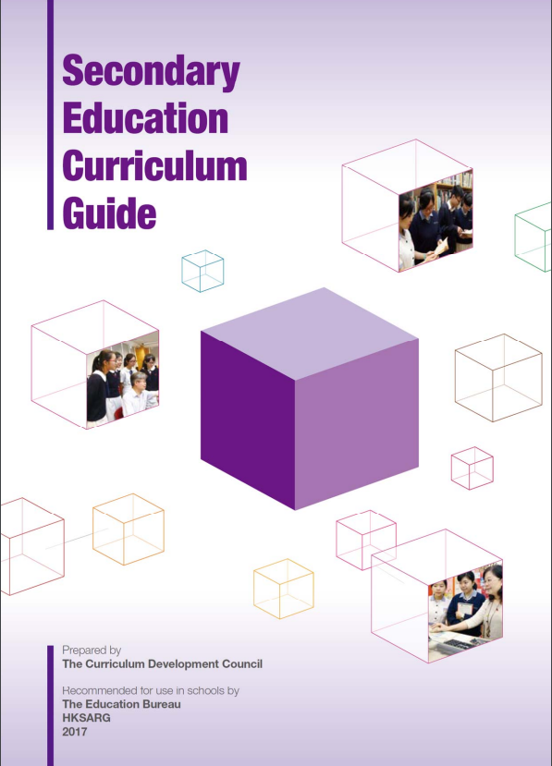
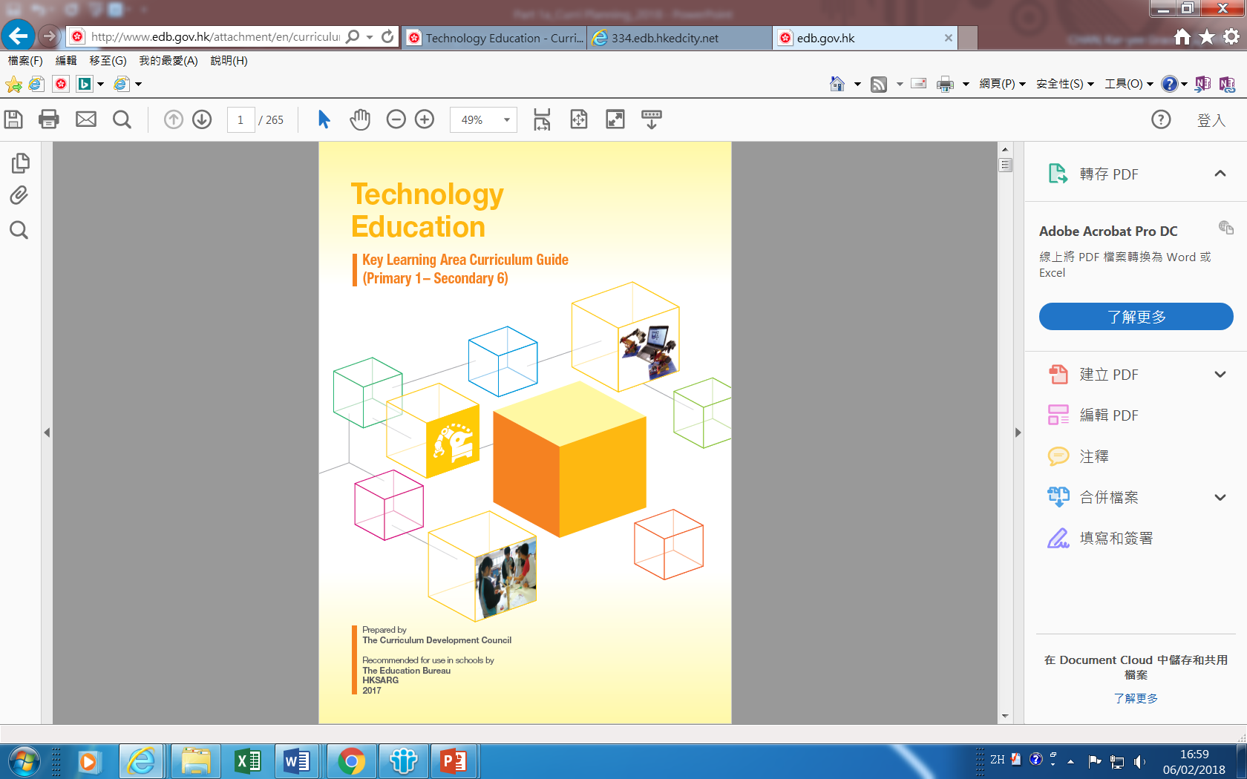
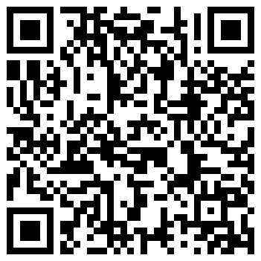
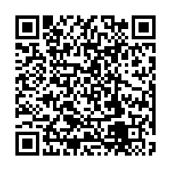
TE Curriculum
Secondary Education Curriculum Guide (Secondary 1 – 6) (2017)
Technology Education Key Learning Area Curriculum Guide (Primary 1 – Secondary 6)
Focus: whole-school curriculum planning and implementation in school

Slide 7
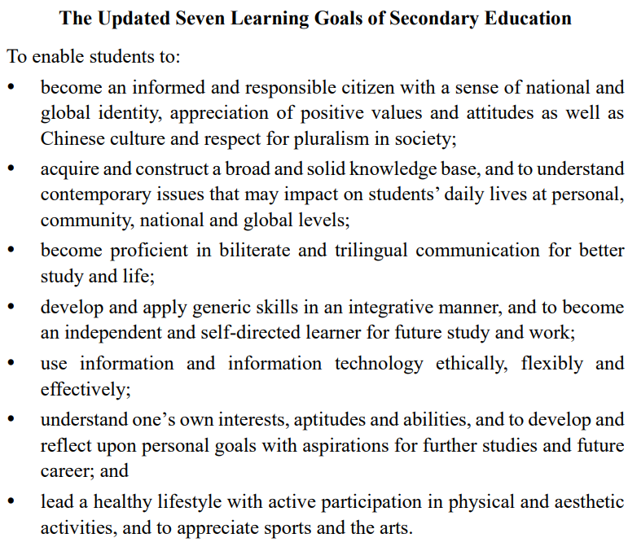
Source: Secondary Education Curriculum Guide (Secondary 1 – 6) (2017), Booklet 1, para.1.6.4,, p.23
https://www.edb.gov.hk/attachment/en/curriculum-development/major-level-of-edu/secondary/curriculum-guides-documents/SECG_booklet_1_en.pdf
National & Global Identity
Breadth of Knowledge
Language Proficiency
Generic Skills
Information Literacy
Life Planning
Healthy Lifestyle

Slide 8
An Overview of Technology &
Position of TE KLA in School Curriculum
Technology is the purposeful application of knowledge, skills and experience in using resources to create products [tools/services] or systems to meet human needs
Technology education is the learning of how human beings solve their daily problems and how the process could be replicated and transferred to solve new problems that arise from time to time
Students are provided with ample opportunities to realise their ideas through hands-on experiences which cater for their interests and learning styles
Identify problems
Search information & find solutions
Select a solution
Plan & implement the solution
Test & evaluate the solution
problem solving skill, etc.
design cycle
design and make
Co-curricular activities and Other Learning Experiences to complement life-wide learning

Slide 9
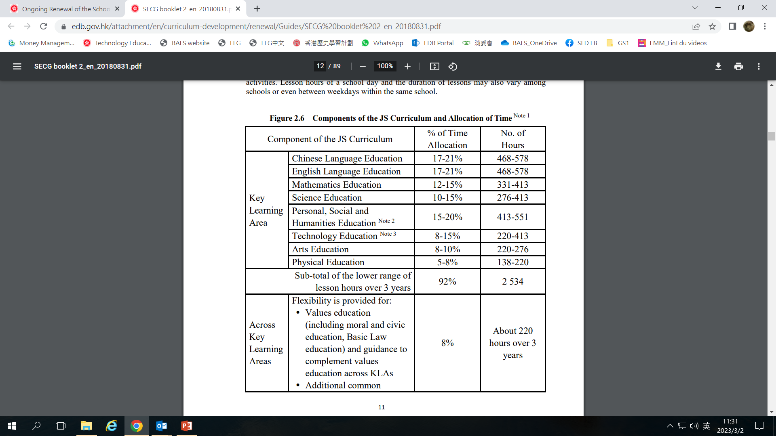
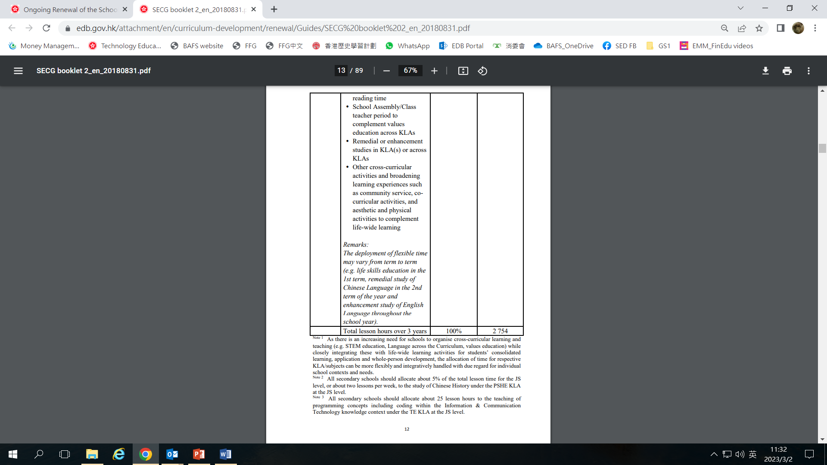
9
TE KLA Curriculum S1-3
Source: Secondary Education Curriculum Guide (Secondary 1 – 6) (2017), Booklet 2, Figure 2.6, p.11-12
https://www.edb.gov.hk/attachment/en/curriculum-development/major-level-of-edu/secondary/curriculum-guides-documents/SECG_booklet_2_en.pdf

Slide 10
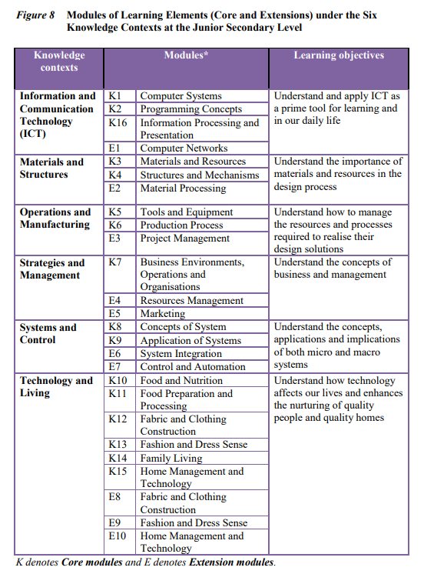
TE KLA Curriculum S1-3
Six TE knowledge contexts with
16 core modules (K)
10 extension modules (E)
Source: Technology Education Key Learning Area Curriculum Guide (Primary 1 – Secondary 6), page 54, Figure 8
Source: Technology Education Key Learning Area Curriculum Guide (Primary 1 – Secondary 6), page 54, Figure 8

Slide 11
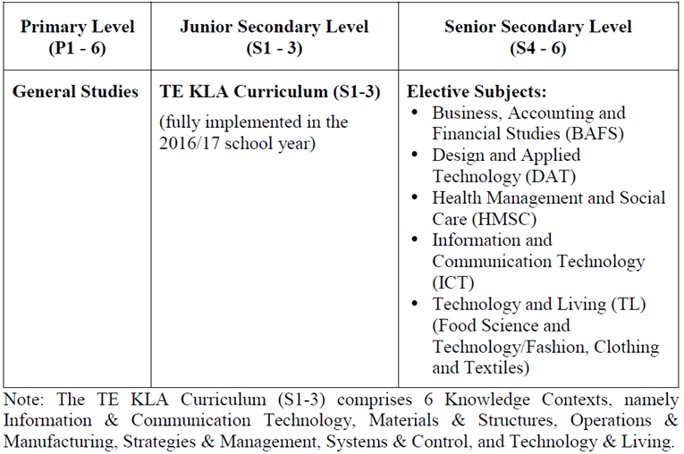
TE KLA Curriculum Framework (S1-6)
Primary Humanities & Science / General Studies
Six TE knowledge contexts with 16 core and 10 extension learning element modules
Source: EDB website
www.edb.gov.hk/attachment/en/curriculum-development/kla/technology-edu/curriculum-doc/TE_KLACG_Eng_5_Dec_2017_r2.pdf
www.edb.gov.hk/en/curriculum-development/kla/technology-edu/resources/InnovationAndTechnologyEducation/resources.html

Slide 12





Latest Development for TE KLA
創新科技教育 - 教學資源連結：
https://www.edb.gov.hk/en/curriculum-development/kla/technology-edu/resources/InnovationAndTechnologyEducation/resources.html
(EDBCM 109/2023)
高小 初中 高中 升學/就業
2023/24 學年開始，學校於高小安排每年每級10-14小時的編程教育
「高小增潤編程教育課程單元」涵蓋編程和計算思維的基本概念包括抽象化、算法和自動化，以及連接實物、運用感測器和執行器與環境進行互動等，讓學生透過學習編程以培養他們計算思維，以及學習創科的興趣和能力
在「資訊和通訊科技」知識範圍安排不少於百分之三十的課時教授程式編寫的概念
於2023/24學年開始在初中推行「初中人工智能課程單元」 ，單元佔10至14小時
涵蓋人工智慧基礎、人工智慧倫理、電腦視覺、電腦語音和語言、虛擬實境、機械人、社會影響和未來工作等課題，進一步鞏固學生的計算思維和加強創科學習
2023年修訂的高中 ICT課程
必修部分(144小時)
  計算思維與程式編寫 (由24課時增至48課時)
  加入創新科技的課題，例如人工智能
選修部分 (76小時)
  三選二
    數據庫
    網絡應用程式開發
    算法與程式編寫
熟練地運用資訊及通訊科技作為支援學科的學習工具
持續進修資訊及通訊科技，以達至業界認可程度，並在工作上有效地運用資訊及通訊科技
成為具道德操守的科技使用者
應用創科能力，造福社會及世界

Slide 13

TE KLA Curriculum – Implementation
TL
CL
BF
Technology
&
Living
Systems
&
Control
Materials
&
Structures
Operations
&
Manufacturing
Information & Communication
Technology
Strategies
&
Management
Aligning subjects/knowledge contexts
Collaborative teaching of subjects/ knowledge contexts
Theme-based learning
Life experiences of students
Source: Technology Education Key Learning Area Curriculum Guide (Primary 1 to Secondary 6), page 121, Fig.10

Slide 14
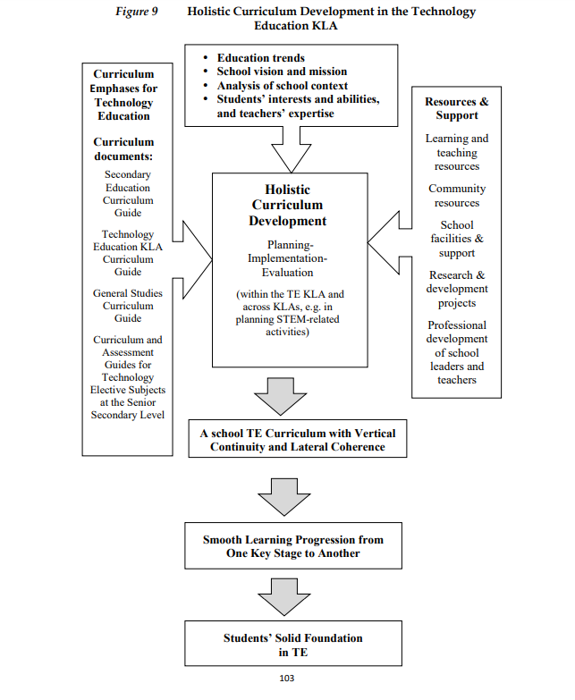
Holistic Curriculum Development in School
Source: Technology Education Key Learning Area Curriculum Guide (Primary 1 to Secondary 6), Fig.9, page 103

Slide 15
Part 1 第一部分
The implementation of TE KLA curriculum (including business learning elements) through holistic curriculum planning at junior secondary level
學校於初中階段通過整體課程規劃以實施科技教育學習領域課程
Highlights of issues when planning and implementing business learning elements at junior secondary level
在規劃與實施初中商業學習元素時的重點事項

Slide 16
Part 1 第一部分
The implementation of TE KLA curriculum (including business learning elements) through holistic curriculum planning at junior secondary level
學校於初中階段通過整體課程規劃以實施科技教育學習領域課程
Highlights of issues when planning and implementing business learning elements at junior secondary level
在規劃與實施初中商業學習元素時的重點事項

Slide 17
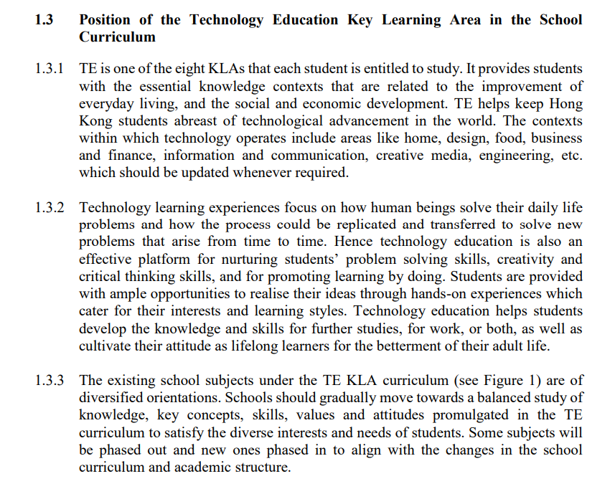
A Quick Recap…
Source: Technology Education Key Learning Area Curriculum Guide (Primary 1 – Secondary 6), page 5, para.1.3
central curriculum
implementation
content coverage

Slide 18
Positioning
Technological literacy –
technological capability,
technological understanding and
technological awareness
Business Learning
Technological literacy | Example for illustration
technological capability | using IT tools to help identify needs/ problems/opportunities in business being able to make informed choices in business (design thinking in business: empathize>define>ideate>prototype>test)
technological understanding | keep abreast with technological trend for better adoption/adaptation to innovative technology (using AI in social media marketing success)
technological awareness | the impact of technological change on business (impact on business model, changes in deployment of resources, etc.)
Notes:
商業教育係初中科技教育學習領域課程中，係點樣體現出嚟既呢？其實我哋希望學生係初中階段，透過商業學習，
明白處身係商業情境裏面，應如何運用資訊科技工具、應點樣去思考，才能作出明智的商業決定
亦要明白緊貼科技創新，例如人工智能發展趨勢對企業營運既重要性
同時明白科技既發展令商業世界不斷改變，直接影響着個人、家庭、社會以至全世界既未來

Slide 19
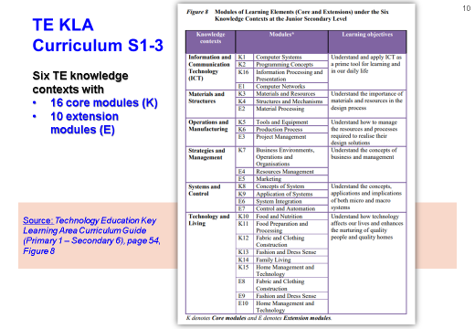
TE KLA Curriculum – Business Learning Elements
Knowledge Context: Strategies and Management

Slide 20
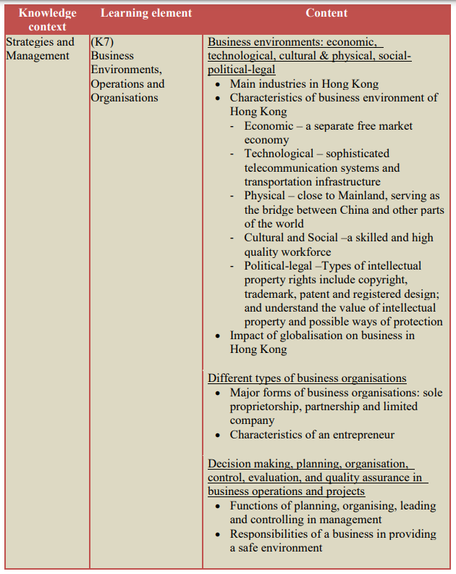
Knowledge Content
Core Module: K7
Source: Technology Education Key Learning Area Curriculum Guide (Primary 1 – Secondary 6), page 80

Slide 21
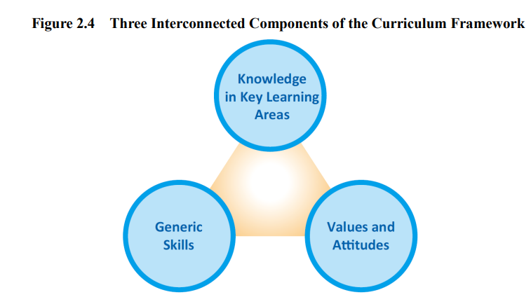
Business Learning –
Knowledge, Skills and Values & Attitude
K-S-A are of equal importance
Immersed in learning within and beyond classroom
Effectiveness of
Business Learning

Slide 22
Lesson Time Allocation
Knowledge context – Strategies and Management | Module K7 Business Environments, Operations and Organisations | 720 mins i.e. 18 lessons (40 minutes a lesson)
 | Module E4 Resources Management | 210 mins i.e. 5-6 lessons (40 minutes a lesson)
 | Module E5 Marketing | 150 mins i.e. 3-4 lessons (40 minutes a lesson)

Slide 23
Part 1 第一部分
The implementation of TE KLA curriculum (including business learning elements) through holistic curriculum planning at junior secondary level
學校於初中階段通過整體課程規劃以實施科技教育學習領域課程
Highlights of issues when planning and implementing business learning elements at junior secondary level
在規劃與實施初中商業學習元素時的重點事項

Slide 24
To think more about … Business Learning
Implementation
…Teaching Approach
…transitory knowledge in nature, not permanent knowledge
…moving from class learning to learning by doing (Attwell, 1997)
…teaching process reveals a teacher’s perception on the subject. It does have impact on students’ learning (周昭和, 2006:69), motivating them to use active learning (Corben & Thomson, 2003)
…all depend on the attitude, competence, responsibilities, compassionate in teaching of a teacher (Fullan, 1991; Rudduck, 1991)
…adjusting teaching approach with pedagogical change (Hodkinson, 1998)
setting authentic questions (Fogarty, 1997; Peterson, 2004; Kumar & Natarajan, 2007…)
problem-based learning in group: constructive learning process to deepen knowledge (Cobb, 1994; Tochon, 2000; Hufferd-Ackles et al, 2004; R.Murray-Harvey et al, 2005; Innes, 2006…)
teacher plays different roles to perform different functions: cheers leader, manager, leader, coach, facilitator… (Peterson, 2004…)
from theory to practice (e.g. case studies)
collaborative learning
pedagogical change

Slide 25
25
Learning Approaches
real world experience
Learning by doing
Trial and error
e.g. case studies, readings
e.g. digital stock trading guru
e.g. quiz competition by HKICPA
e.g. MEP (和富千禧企業家精神)
e.g. JA Company Programme
e.g. 趁墟做老闆, a bazzar in school
e.g. mini project
e.g. LNY Fair
e.g. STEAM project
developing/enriching students’ business learning experience within & beyond classroom

Slide 26
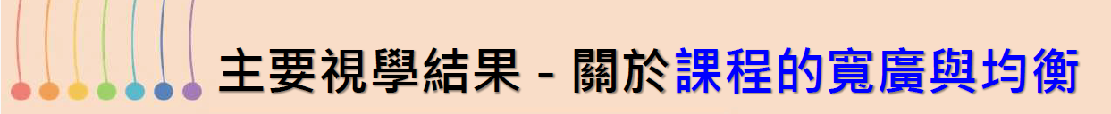
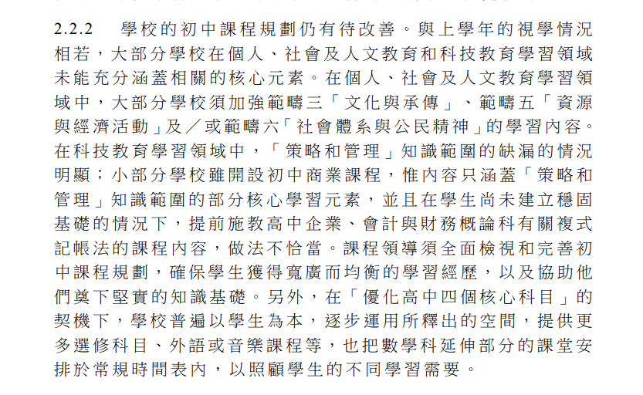
2022/2023
視學周年報告 ，第3頁，段2.2.2
https://www.edb.gov.hk/tc/sch-admin/sch-quality-assurance/reports/insp-annual-reports/index.html

Slide 27
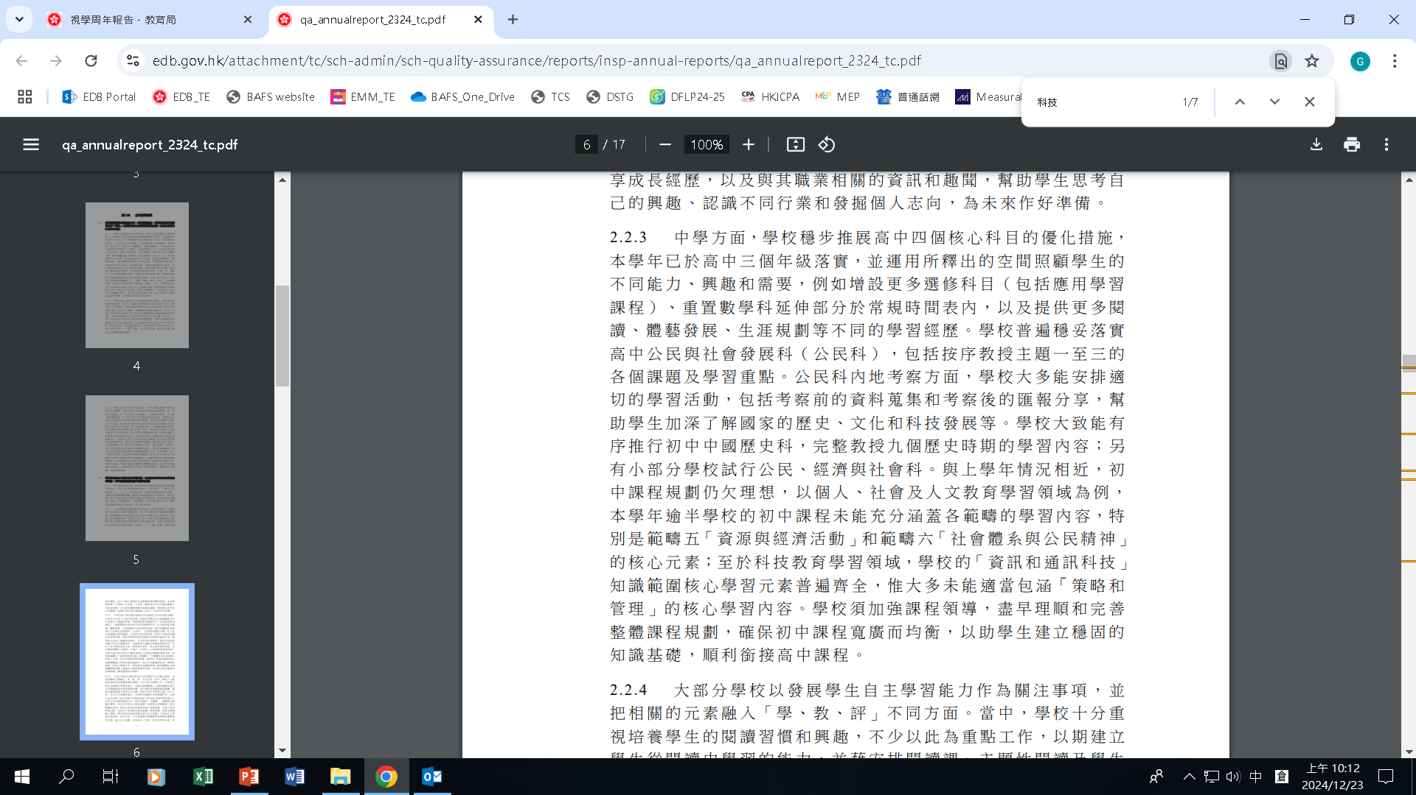
2023/2024
視學周年報告 ，第4頁，段2.2.3
https://www.edb.gov.hk/tc/sch-admin/sch-quality-assurance/reports/insp-annual-reports/index.html

Slide 28
What do you think …
“… K7 learning elements are covered in topics like Business Environment of HK and Impact of globalisation on business in Hong Kong of the Life and Society Subject or Citizenship, Economics and Society (CES) subject …”
“… I have already introduced various learning activities for JS students … collaborate with different organisations, join their business-related programmes and provide students with ample opportunities to develop business knowledge, as well as nurture their financial literacy and entrepreneurial spirit ... such as LNY fair, digital stock trading guru competition … K7 learning elements have already been incorporated into different activities … is it okay to satisfy the implementation of business learning in JS on a whole? ...”

Slide 29
Points-to-note when Planning & Implementing
Business Learning in S1-3
PSHE
ME
TE
Other KLAs
Knowledge, skills & values to learn
Within & beyond classroom
Real-life context
Holistic Curriculum Development in School
Collaboration within & across KLAs/subjects
Source: Technology Education Key Learning Area Curriculum Guide (Primary 1 to Secondary 6), Fig.9, page 103
Effectiveness of
Business Learning

Slide 30
Points-to-note when Planning & Implementing
Business Learning in S1-3
Subject code
(collecting case studies, sharing media articles, reading books, …)
allocation of lesson time
Business learning in S1-S3
vs
BAFS in S4-S6 (age appropriateness)
Subject name
content coverage of TE KLA
authentic learning experience/activities
Notes:
當然，初中科技教育學習領域課程係中央課程，應佔課時，而K7單元既商業學習元素，都應該佔課時
有部分學校現行既初中課程已經涵蓋K7單元內容，如果未有涵蓋既話，就需要有所安排，確保所有初中學生學到K7內容
剛才潘校長都講過，係科技教育學習領域課程指引中，提及可運用不同既實施模式，但大前題，都係要確保每一個學生，係初中階段都能學到16個核心單元內容，包括K7單元既商業學習元素
就商業學習既特點，K7、E4或E5既學與教實踐係以商業情境為背景，以培養學生既基礎商業知識、能力與態度，係第二部分，兩間學校係呢方面就會跟我哋一齊分享多一啲
換言之，係初中學校課程安排商業學習元素時，有幾點要注意既：
K7單元係科技教育既一部分，亦係中央課程既一部分，學校應該編排課時教授K7單元
科目名稱方面，唔可以用高中科目名稱，即係企業、會計與財務概論、會計、商業管理都唔可以用
學校每年回覆教授K7單元的課程代碼時，可選擇899，即「其他」呢個課程代碼
初中商業學習元素係指K7單元內容，唔好將高中企業會財科內容提早於初中任教
同工可以採用多元化既教學方式，(enter) 包括：運用商業個案和商業題材既書籍內容、情境性學習、閱讀有關商業的報導及文章等，引起學生既學習興趣，培養佢哋自學習慣
如果學校選擇將K7內容與現行初中課程融合，不會有獨立課時教授K7單元內容的話，學校就要有好好規畫，顯示有配合K7單元內容既學與教，例如有關科目既scheme of work/教學進度表、課堂學習活動、家課記錄等

Slide 31
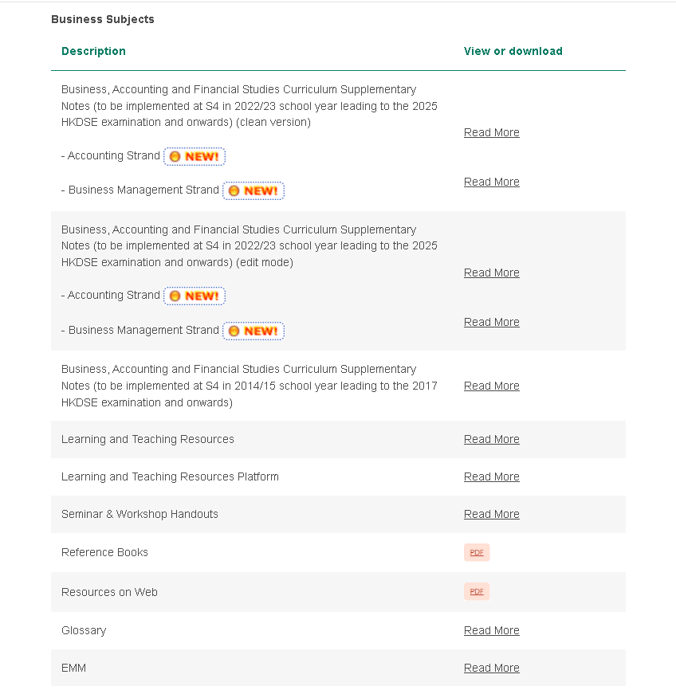
Resource Materials for Business Learning (S1-6)
https://www.edb.gov.hk/en/curriculum-development/kla/technology-edu/resources/index.html
BAFS Supplementary Notes
Learning & Teaching Resources
BAFS glossary book

Slide 32
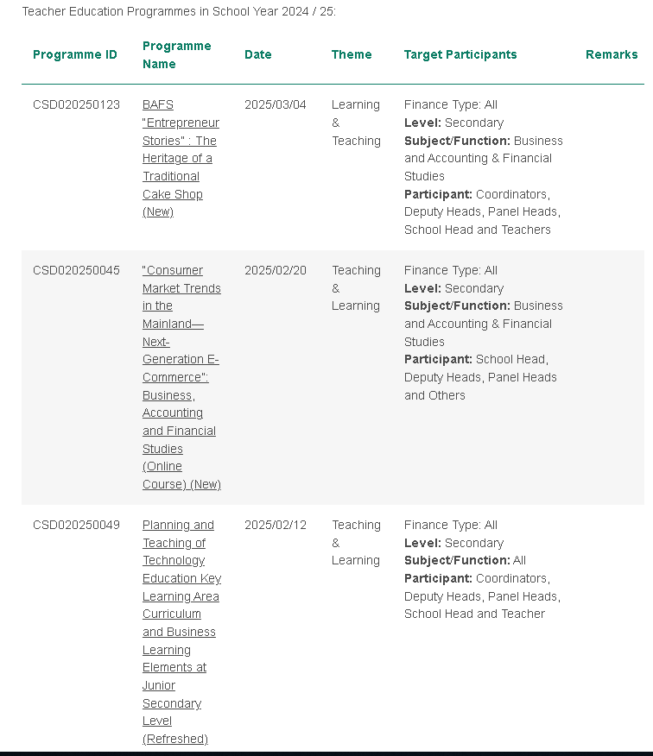
PDPs on Business Learning (S1-6)
https://www.edb.gov.hk/en/curriculum-development/kla/technology-edu/teacher-edu-program/index.html
CSD020250123
BAFS “Entrepreneur Stories”: The Heritage of a Traditional Cake School (New)
企業會財「企業家故事」：一間傳統餅店的承傳
CSD020250045
“Consumer Market Trends in the Mainland
—Next-Generation E-Commerce”
「電商熱潮推陳出新─內地市場發展趨勢」

Slide 33
Part 2 第二部分
School Sharing 學校分享
Experience Sharing on Planning and Teaching of TE KLA Curriculum (including Business Learning Elements) at Junior Secondary Level
規劃與實施初中科技教育學習領域課程（包括商業學習元素）的經驗分享

Slide 34
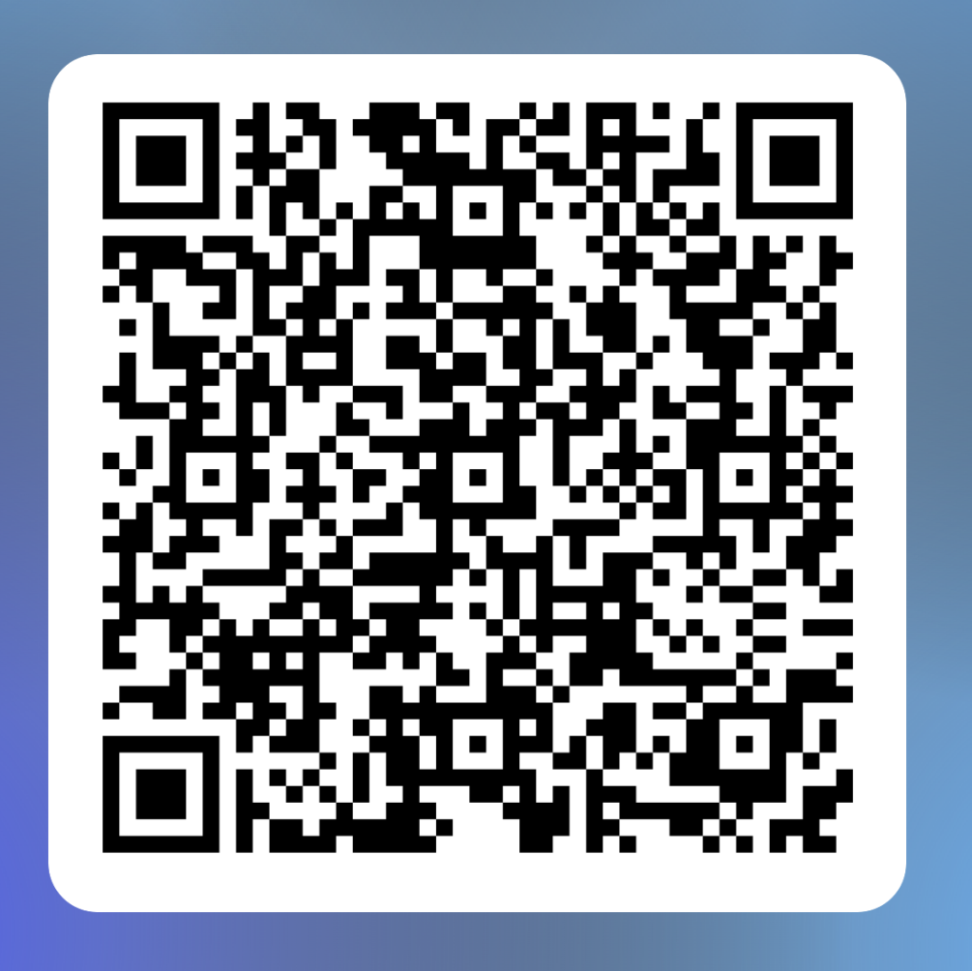
Evaluation Form
Q & A

